Slide 1
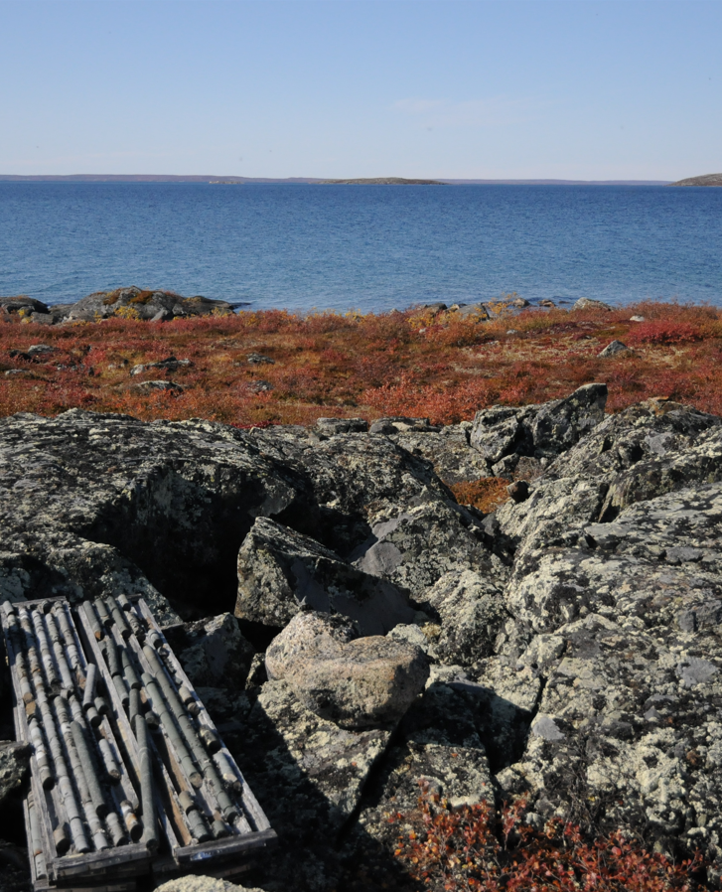

Closure and Reclamation Planning in the Mackenzie Valley
MVRMA Workshop, June 2022
Notes:
Closure and Reclamation Planning in the Mackenzie Valley.
This presentation is an introduction to closure and reclamation planning under the Mackenzie Valley Resource management Act (or the MVRMA). Although this presentation focuses on mining, the closure and reclamation planning principles at mines can be used for other industries too, such as oil and gas.
First, we’ll start with a bit of history about mine closure in the Mackenzie Valley.

Slide 2
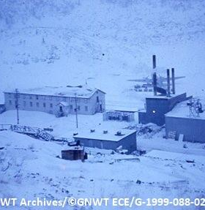
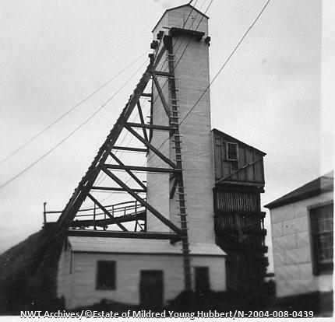
The Past
Port Radium
Discovery Mine
Notes:
Since the 1930s, there have been several mines built in the Mackenzie valley. Silver mines, uranium mines, gold mines, diamond mines and more. Mining shaped the economy of the Northwest Territories, then and now. Unfortunately, some mines from the past were abandoned when companies went bankrupt. At others, the knowledge, standards, and expectations for closing a mine were simply not what they are today.

Slide 3
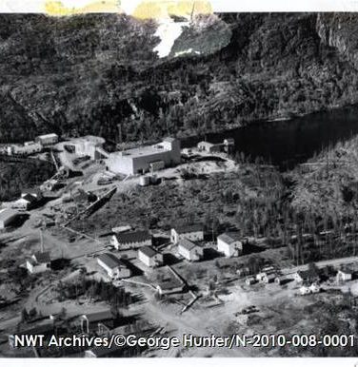
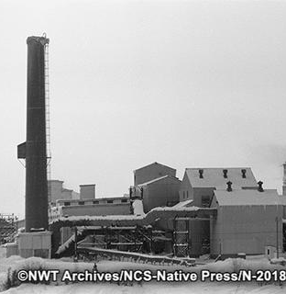
The Past
Rayrock Mine
Giant Mine
Notes:
As a result, there were significant adverse impacts from abandoned mines many years after mining stopped. In some cases, there was great loss of culture and people’s way of life in and around these sites.

Slide 4
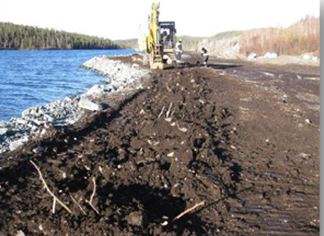
The Past
Remediation Work at the Colomac Mine
Source: GNWT Environment and Natural Resources (https://www.enr.gov.nt.ca
Notes:
The federal government has done a lot of work in the North to remediate abandoned mine sites, and continues to do so today. The vast majority of this work is paid for with taxpayer money.

Slide 5
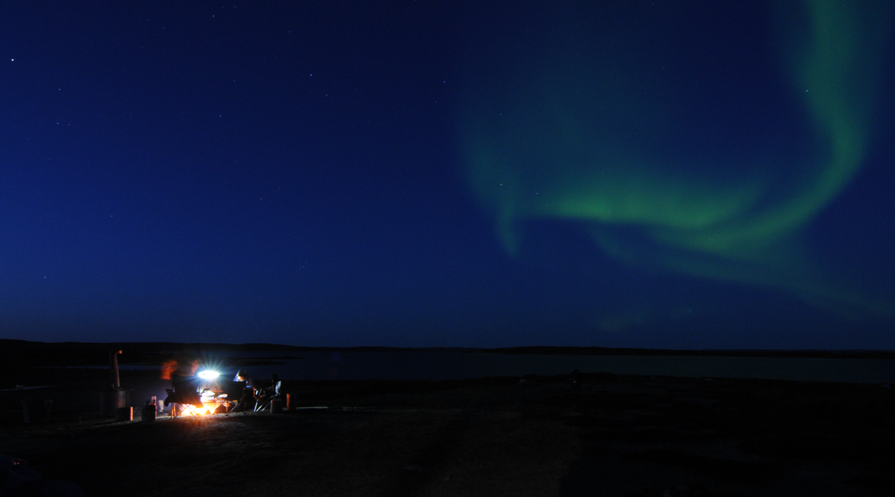
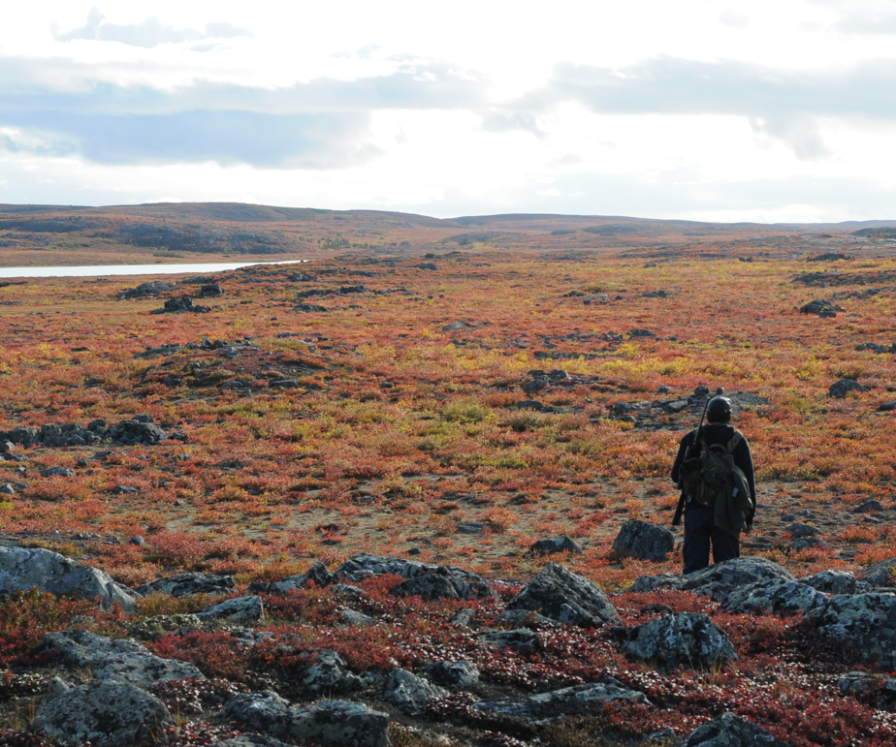
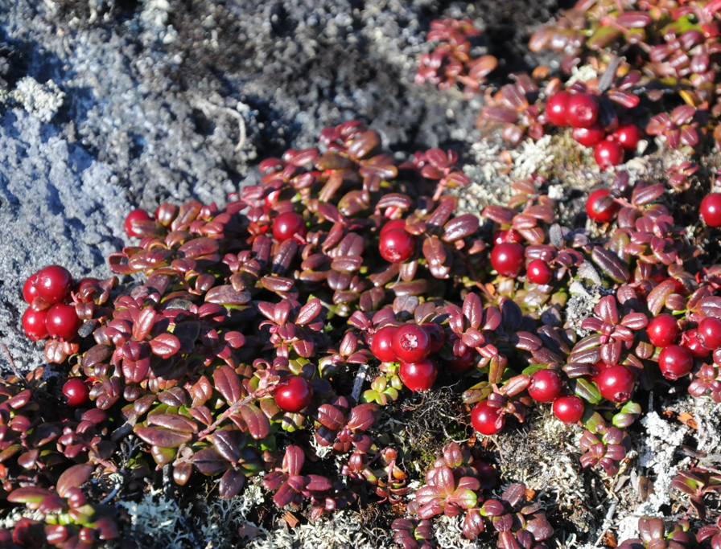
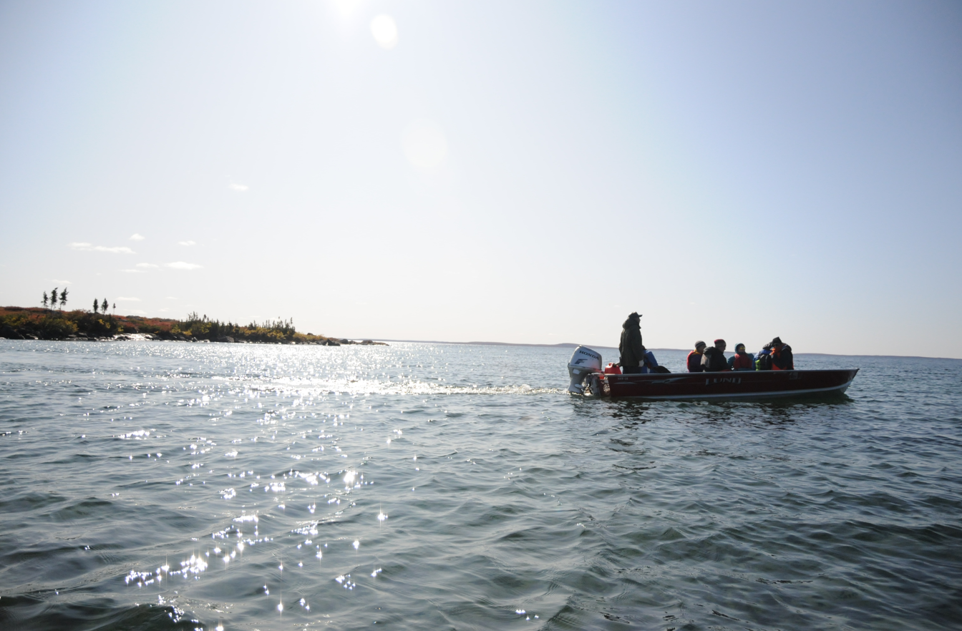
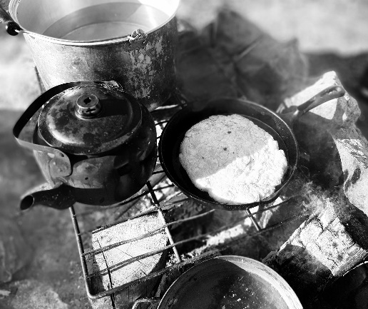
Photo credit: Wek'eezhii Land Water Board
Notes:
The legacy from these abandoned mine sites impacted how a lot of people in the north think about mining and mine closure. How will today’s mines be closed? Will the land, the water, the wildlife be protected after mining is done? Will people be able to safely use the land, drink the water, hunt, and fish in and around the mine site again? Will people’s culture, their way of life, be preserved for future generations?

Slide 6
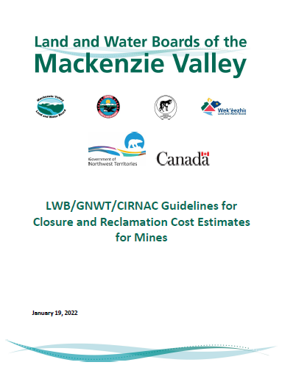
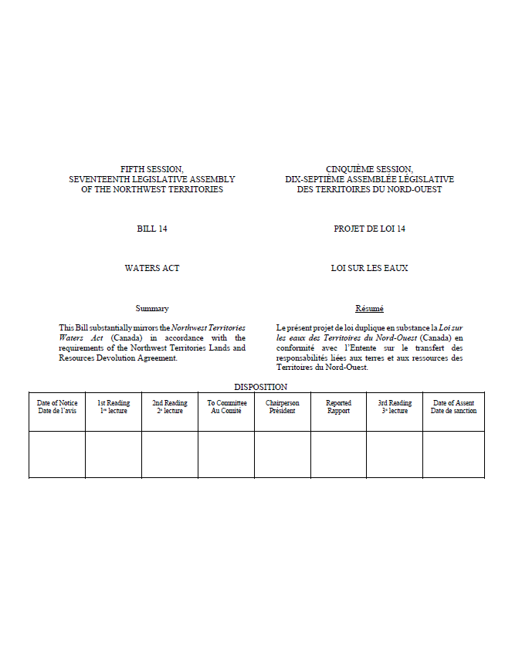
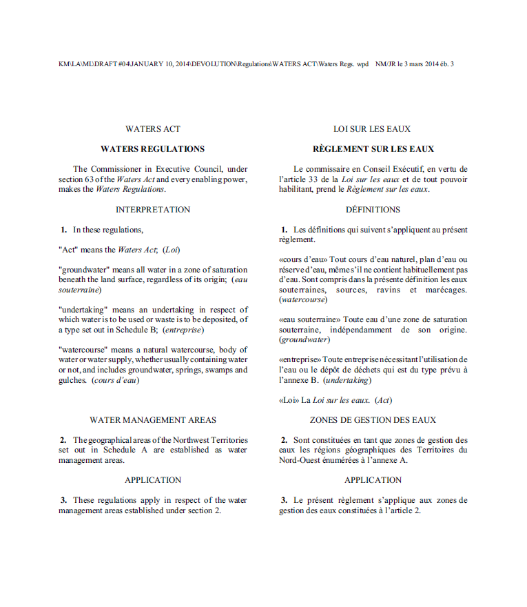
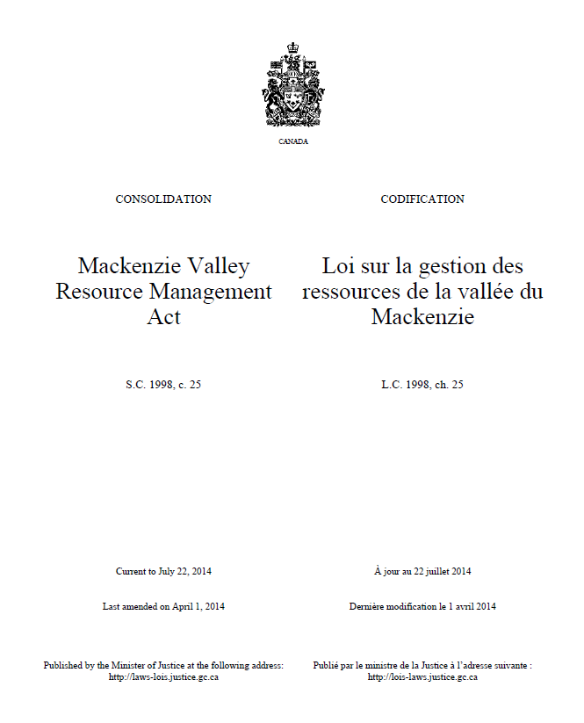
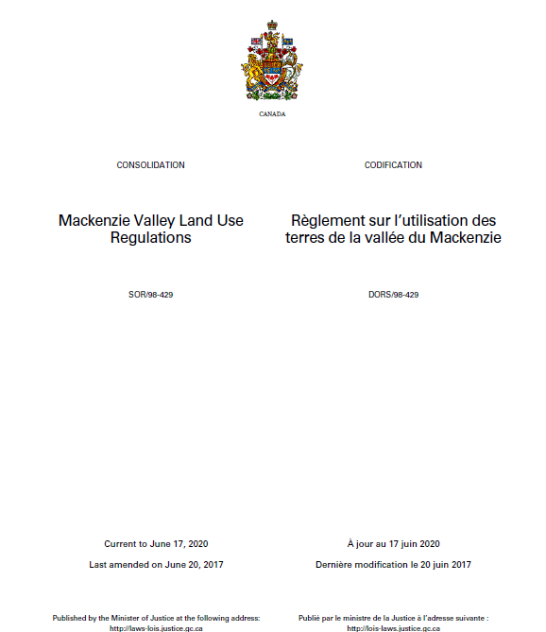
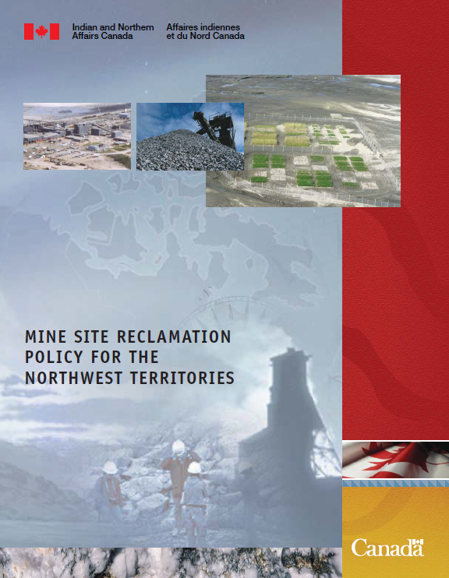
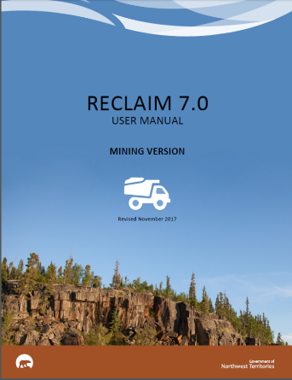
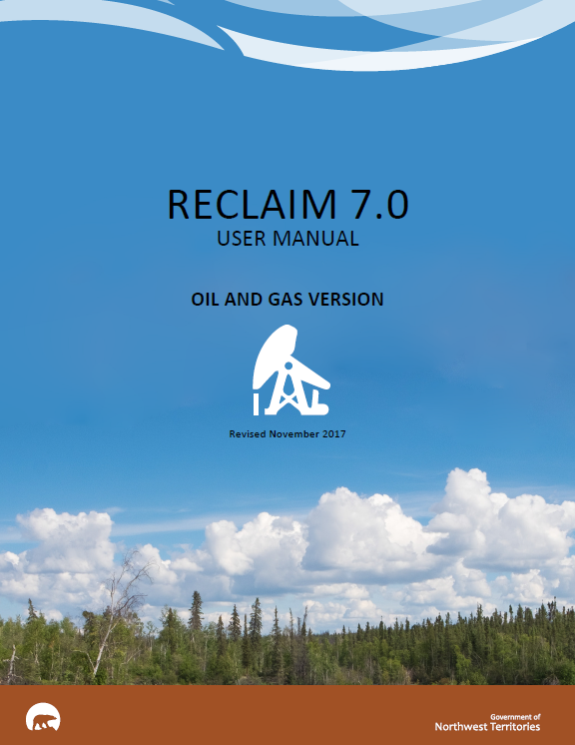
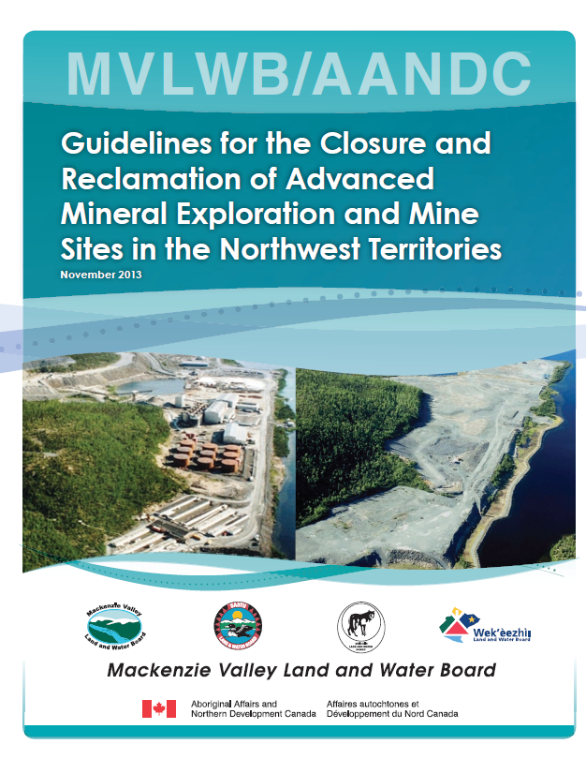
The Present
Laws
Regulations
Policies
Guidelines
6
Notes:
In Canada and around the world, there have been many closure and reclamation planning improvements in recent decades. For example there have been improvements in scientific knowledge, incorporation of Traditional Knowledge, mining company policies, and regulatory standards. Under the MVRMA, the Review Board and the Land and Water Boards play a key role in ensuring modern closure and reclamation planning standards are upheld. These co-management Boards are supported by laws, regulations, policies, and guidelines. The Boards can set legally binding requirements related to mine closure and reclamation.

Slide 7
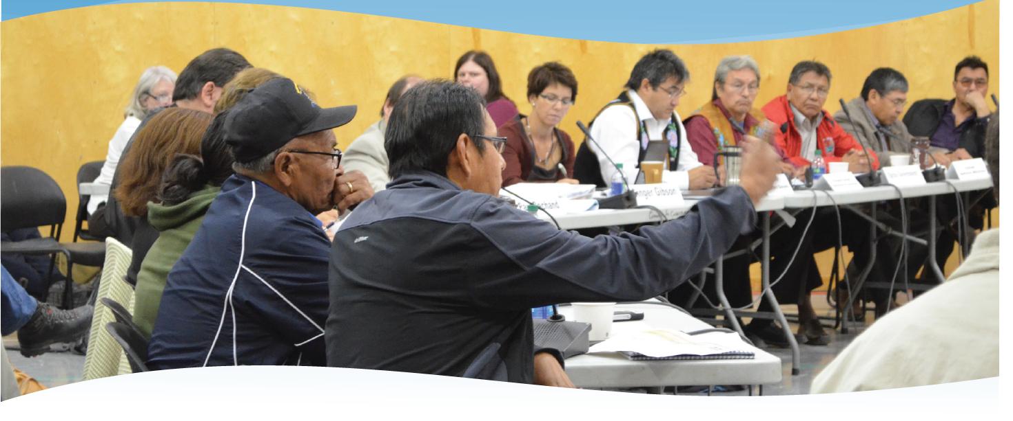
The Present
Source: MVLWB Engagement and Consultation Policy, www.mvlwb.ca
Engagement & Consultation
Notes:
Under the MVRMA, Indigenous Governments and Organizations, watchdog organizations, federal and territorial governments, and the public can provide input at all stages of closure and reclamation planning. This involvement starts before a project is approved and continues until well after a mine is closed. The Boards have a policy and guidelines that lay out the expectations for good engagement and consultation.

Slide 8
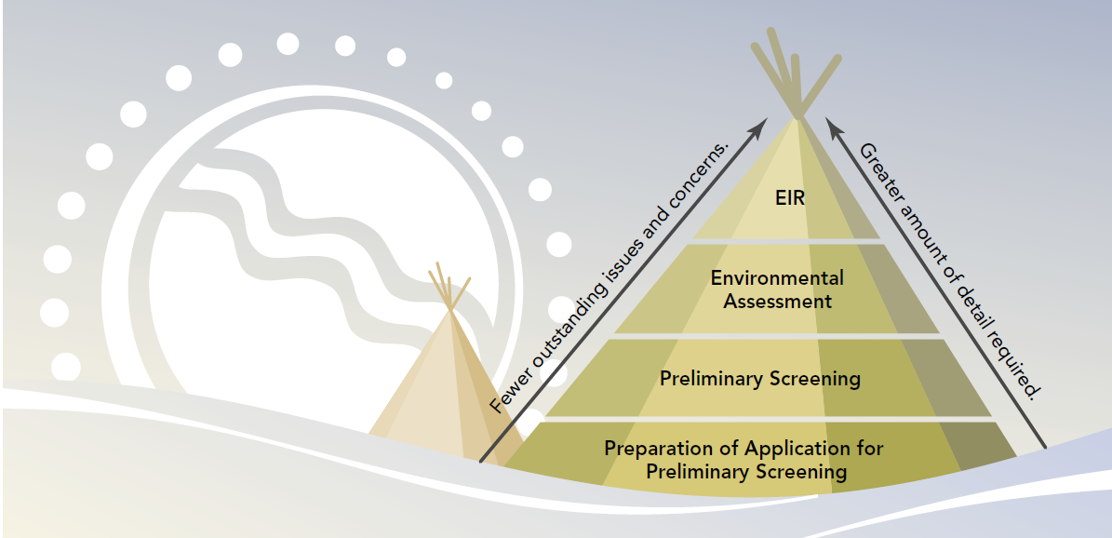
The Present
Notes:
In the Mackenzie Valley, a company that wishes to open a mine must apply for a land use permit and water licence. This triggers a preliminary screening, to see if there might be significant adverse impacts or public concern. If so, the proposed mine will go to the Mackenzie Valley Review Board for an environmental assessment or an environmental impact review. These are public processes. At this stage, a mine will have a conceptual closure and reclamation plan. Although this early plan will not yet have a lot of detail, important closure and reclamation planning decisions are often made during the environmental assessment.

Slide 9
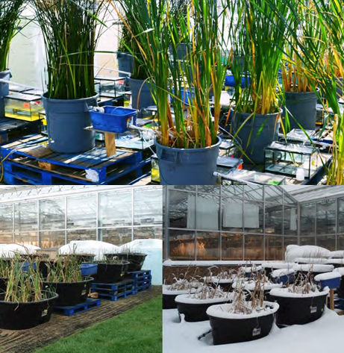
The Present
Environmental Assessment Measures
Source: Fortune Minerals Licence Proceeding Public Hearing Presentation 2014; https://wlwb.ca/registry
Notes:
For example, during the Environmental Assessment for the Fortune Minerals’ NICO mine, the MV Review Board decided that Fortune Minerals must conduct rigorous studies to help design constructed wetlands These wetlands will treat seepage water after closure. Other examples of environmental assessment outcomes related to closure could involve mining methods, the location or design of waste rock and tailings piles, use of Traditional Knowledge, monitoring requirements, and more.

Slide 10
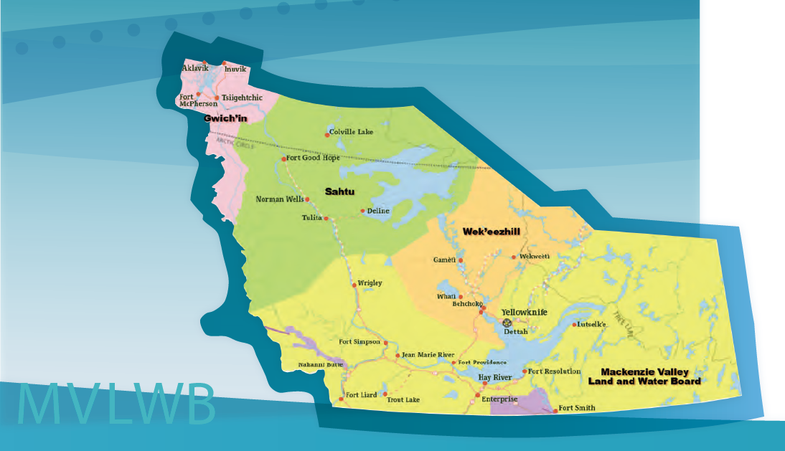
The Present
The Land and Water Boards
Notes:
After the Review Board approves a project, the company’s application goes back to the Land and Water Board for licensing and permitting. Again, the Land and Water Board holds a public process to inform the licence and permit requirements. The conceptual closure and reclamation plan may be updated at this stage.

Slide 11
The Present
OPERATIONAL MINE LIFE
Interim
Closure and Reclamation Plan
Version 1
Interim Closure
And Reclamation Plan
Version 2
Interim Closure and Reclamation Plan Version 3
INCREASING DETAIL
Notes:
After the Land and Water Board issues a licence and permit, the company will typically be required to submit an interim closure and reclamation plan. This will build on the conceptual plan submitted during the environmental assessment. Throughout the life of the mine, the company will be required to regularly submit updated versions of the interim plan, for example every three years. Each version will have more detail and more resolved issues. Each version will undergo a public process with engagement and consultation.

Slide 12
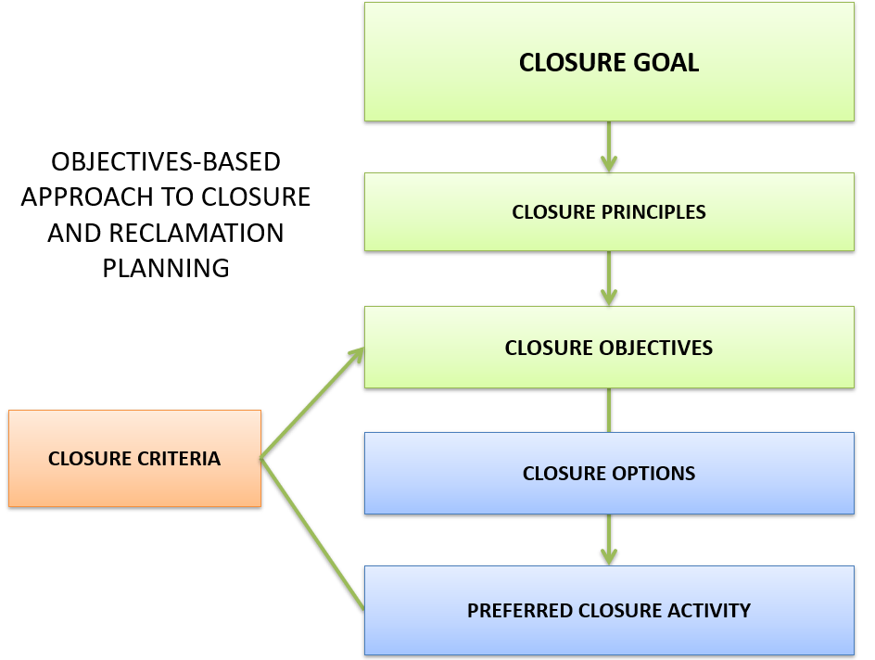
The Present
Notes:
The water licence and land use permit will require the company to follow the Guidelines for the Closure and Reclamation of Advanced Mineral Exploration and Mine Sites in the Northwest Territories. These Guidelines lay out in detail, a robust and transparent closure planning process. The minimum closure goal for new mines in the Mackenzie Valley, as described in the Guidelines, is “to return the mine site and affected areas to viable and, wherever practicable, self- sustaining ecosystems that are compatible with a healthy environment and with human activities”. The diagram on this slide depicts the main parts of the closure planning approach in the MV.

Slide 13

The Present
Traditional Knowledge in Closure and Reclamation Planning
Notes:
In all stages of closure and reclamation planning, Traditional Knowledge can play a very important role. In the Mackenzie Valley, there are many examples of Traditional Knowledge that has been provided to improve closure and reclamation plans. For example, Traditional Knowledge can help to design waste rock and tailings piles to minimize the impact on caribou and other wildlife. Traditional Knowledge can inform what plants to plant on the closed site, and where to plant them. It can inform how to know whether water quality and fish health are good after closure. The Land and Water Boards typically include water licence and permit requirements to promote the use of Traditional Knowledge.

Slide 14
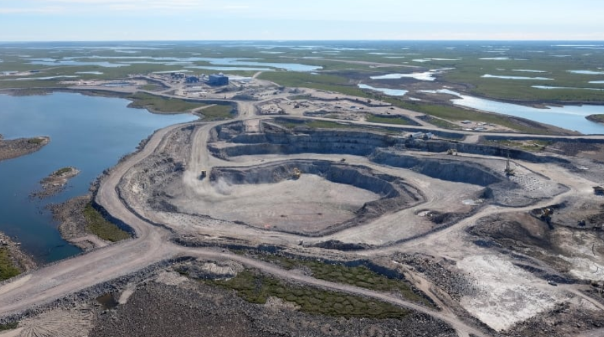
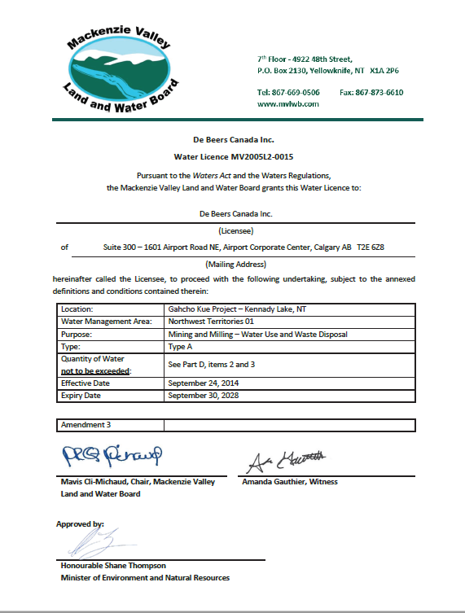
The Present
Source: https://www.cbc.ca/news/canada/north/debeers-gahcho-kue-diamond-mine-online-1.3706071
Gahcho Kue
Water Licence
Notes:
Water licences and land use permits often have requirements specific to closure and reclamation. For example, the licence for the Gahcho Kue mine requires a research plan related to the waste rock pile cover. Water licences require regular reporting on closure and reclamation planning progress. Reports are required once closure and reclamation work has been completed, to document that work was done properly. Licences also require performance assessment reports, to describe how well the closure and reclamation plan is working. These requirements improve accountability and transparency.

Slide 15
The Present
Mine | Land and Water Board Security Deposit
Gahcho Kue | $83 million
Ekati Mine | $260 million
Snap Lake Mine | $74 million
Diavik Mine | $199 million
Imperial Oil | $180 million
Notes:
Another major change in recent decades is that mining companies must put down a financial deposit so there is money to cover the cost of closing the mine. If the company goes bankrupt, the federal or territorial government will use this money to close and reclaim the mine. This slide shows some examples of the security deposits at mines in the Mackenzie Valley. The Land and Water Boards set the amount of the security deposit. The company then posts this amount with the federal or territorial government.

Slide 16
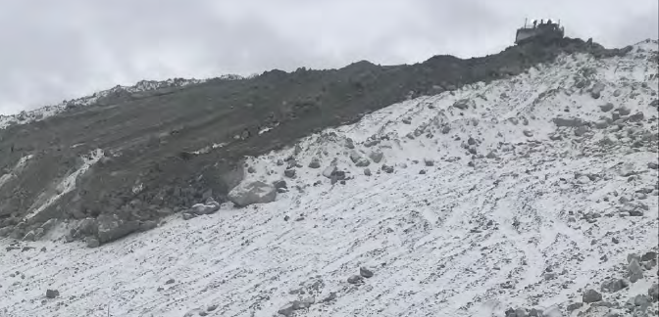
The Present
Early Waste Rock Cover Construction at the Diavik Mine
Source: DDDMI Reclamation Completion Report, 2018. wlwb.ca/registry
Notes:
Water Licences usually have requirements for progressive reclamation. This is when a company close parts of the mine while the mine is still in operations. This early work can have environmental benefits. Also, companies can get some of their security deposit back if they do this work, and it can be more cost effective for them to do the work while equipment, personnel, and winter roads are in place. For example, at both the Ekati and Diavik mines, the mining companies have placed a closure cover on top of some waste rock piles, even though these mines are still in operations.

Slide 17
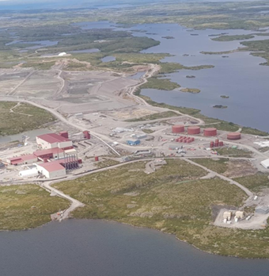
The Present
Snap Lake Mine
No longer in operations
Source: Source: De Beers Snap Lake Final CRP, Version 1.1 2021. http://mvlwb.com/registry/
Notes:
The Water Licence also requires a mining company to submit a final closure and reclamation plan to the Land and Water Board about two years before operations end. At this point, all research should be done, all closure planning issues should be resolved and the level of detail in the plan should be very high. Of the mines that were approved and licenced under the MVRMA, the Snap Lake mine may be the closest to submitting a final closure and reclamation plan, now that mining has stopped at Snap Lake. The Diavik mine will be submitting its final closure and reclamation plan at the end of this year, in preparation for its planned end of life in 2025.

Slide 18
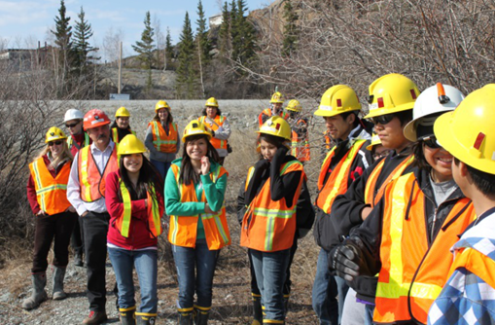
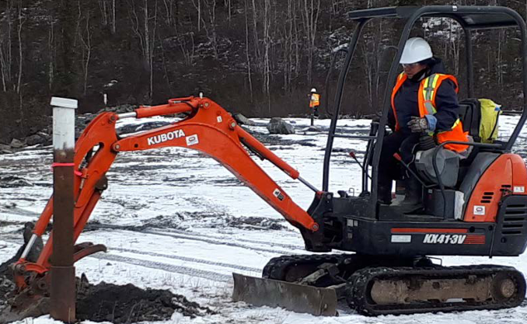
The Future
Monitoring the success of closure and reclamation
Source: Monitoring of Remediated Federal Contaminated Sites in the NWT, CIRNAC 2017 https://nwtdiscoveryportal.enr.gov.nt.ca/geoportal/catalog/main/home.page
Notes:
As these newer mines close, how will we know whether their closure and reclamation plans have been successful? How will we know if closure goals and closure objectives have been met? Will these mine sites be returned to self- sustaining ecosystems that support future use for many generations. The answers to these questions will come in part from the monitoring that mines are required to perform after closure. Monitoring may be required for years or decades before success can be demonstrated and all of the security deposit can returned. Community engagement and traditional knowledge will play a key role in this monitoring. While we don’t know the answer to these questions yet for the mines in the Mackenzie Valley, the improvements in mine closure and reclamation planning standards and expectations leave room for optimism.

Slide 19
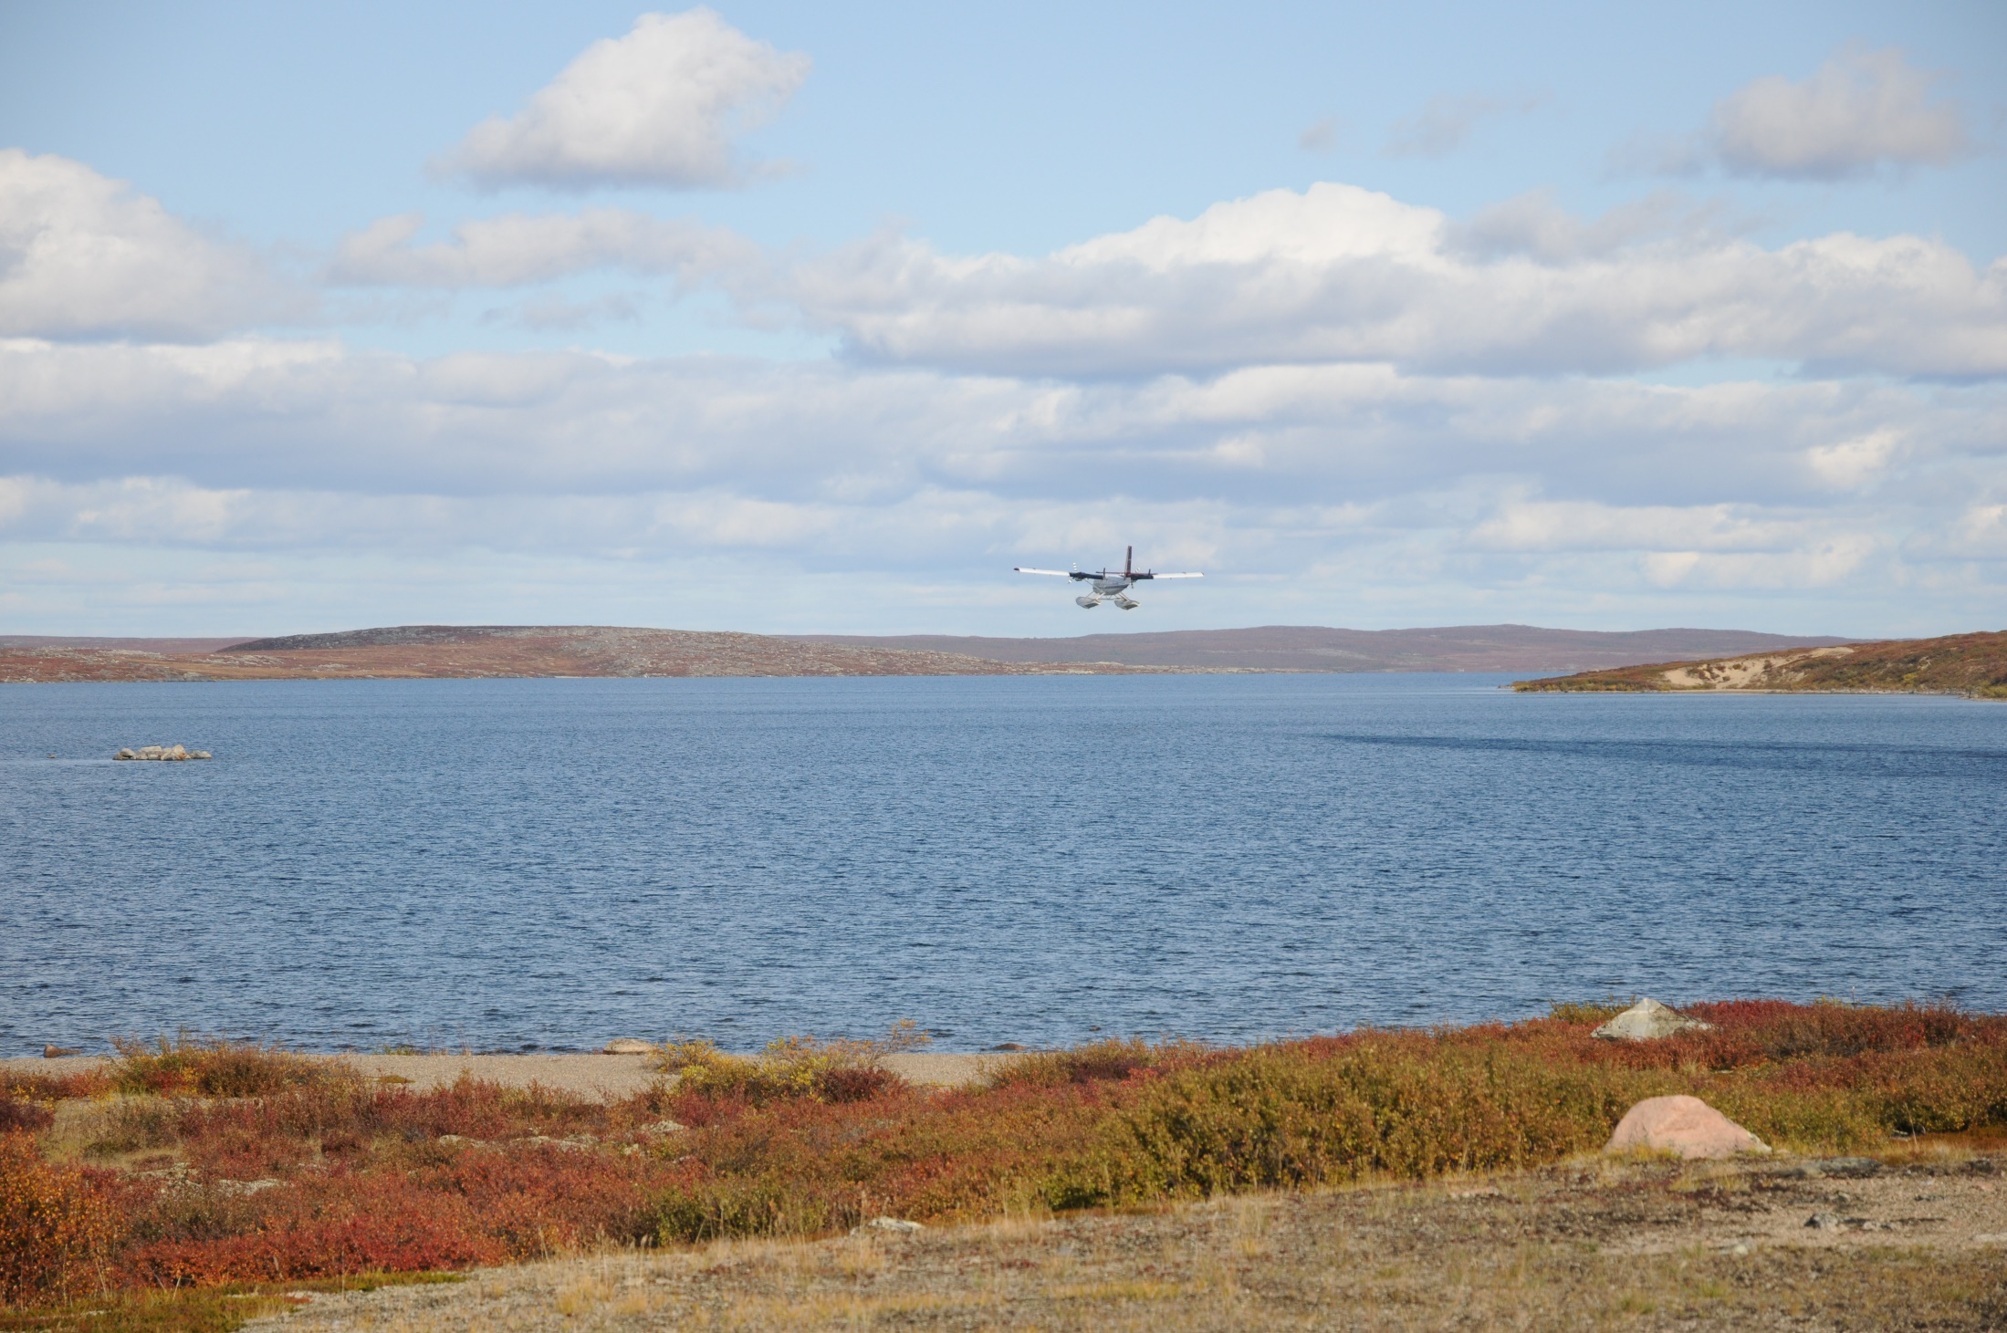
Masi
Notes:
We hope this presentation has given you a big picture view of closure and reclamation planning in the Mackenzie Valley. Masi Cho.

